Slide 1
Do You See What I See: Stereotype Threat and the Classroom
BCC Inclusion Council

Slide 2
Inclusion Council

Slide 3
THINK, PAIR, SHARE
What is the state of inclusion at your school?

Slide 4
Butler Community College Inclusion Council
BCC Inclusion Statement: In support of its institutional values, Butler Community College nurtures
diversity and inclusion through the practice of Cultural Competency, an ever-evolving concept that
recognizes, supports, and embraces the understanding of human difference. Through culturally
competent behaviors, attitudes, instruction, and policies, Butler promotes a diverse educational
experience, fosters inclusivity to ensure student success, and contributes to the vitality of the institution and the communities it serves.

Slide 5
Give One, Get One

Slide 6
Does the phenomenon of stereotype threat support or work against the explanation you came up with for the scenarios?

Slide 7
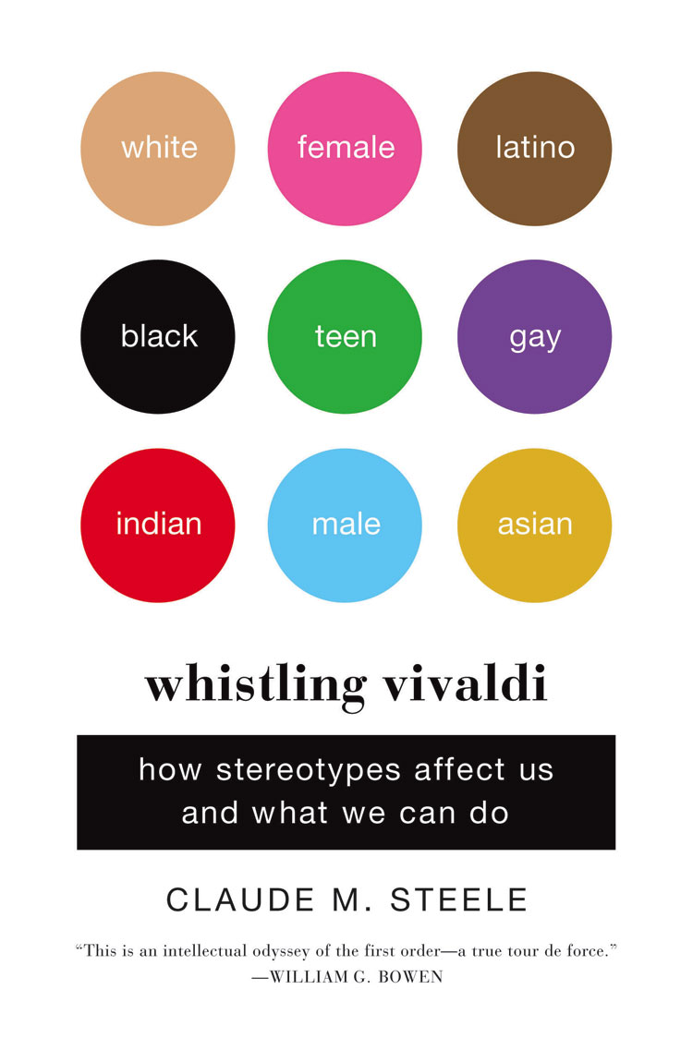
Stereotype threat
PRAXIS
Theory
2. Practice

Slide 8
Jigsaw Shuffle
What stereotype threats might be active in various spheres of an institution of higher education?

Slide 9
Administration
Instructor
Curriculum
Developmental Education
Workplace

Slide 10
Imagine ways to deactivate stereotype threat in each sphere.

Slide 11
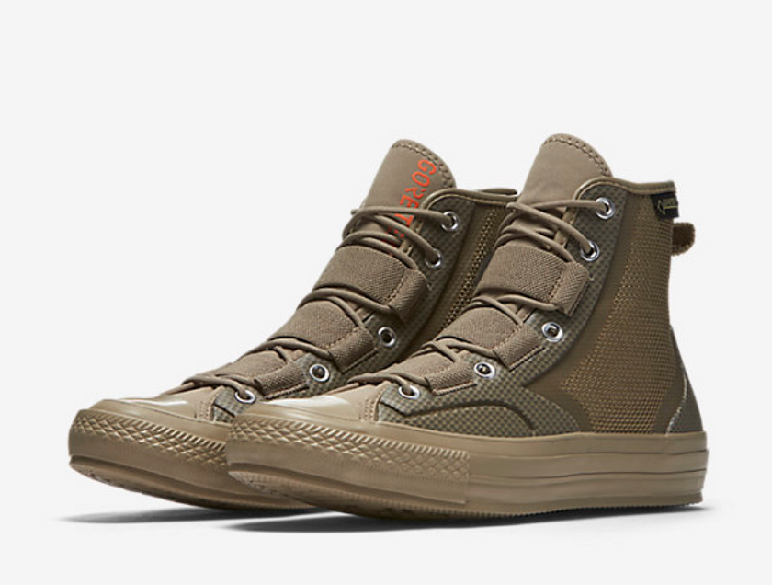
Combating stereotype threats in your field and your classroom

Slide 12
Combating Stereotype Threat

Slide 13
