Slide 1
Inductive Grammar
Rigor, Relevance, and Success
Notes:
________________________________________________________________________________________________________________________________________________________________________________________________________________________________________________________________________________

Slide 2
Inductive Grammar: Overview
Definition: Allows/requires students to use inductive logic to determine rules that drive grammar & usage
Rationale: May be more effective and closer to students' writing process than traditional grammar instruction
Challenges:
Scheduling sufficient time
Wide variation in students' base knowledge
Example
Example
Example
Conclusion & Application
Notes:
________________________________________________________________________________________________________________________________________________________________________________________________________________________________________________________________________________

Slide 3
Example Activity: Background
ALP Fundamentals class
8 students
1st paper completed, showing common weaknesses in sentence boundaries
5th week of semester
Grammar work already completed on punctuation in Fundamentals and "connecting words" (coordinating and subordinating conjunctions) in Comp 1
Notes:
________________________________________________________________________________________________________________________________________________________________________________________________________________________________________________________________________________

Slide 4
Exercise Goals
Students will learn about sentence boundaries
Students will engage with different types of sentences and build instinct for sentence completion
Students will practice analyzing and interpreting sentences
Students will explore the idea that grammar conveys meaning
Notes:
________________________________________________________________________________________________________________________________________________________________________________________________________________________________________________________________________________

Slide 5
Developing the Exercise
Desired outcomes Content & approach
Previously covered content + New ideas + Analytical skills
Tweaked wording and execution to avoid unnecessary confusion and focus on outcomes
Notes:
________________________________________________________________________________________________________________________________________________________________________________________________________________________________________________________________________________

Slide 6
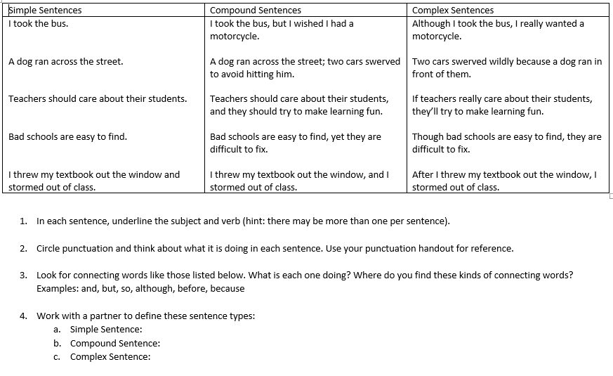
Notes:
________________________________________________________________________________________________________________________________________________________________________________________________________________________________________________________________________________

Slide 7
Results
Common vocabulary for discussing sentence-level issues
Marked improvement in sentence boundaries for all students, throughout the semester
Frequent use of more complex sentences
Deeper analysis into ideas, including analysis of authors' rhetorical techniques
Notes:
________________________________________________________________________________________________________________________________________________________________________________________________________________________________________________________________________________

Slide 8
Crucial Considerations
Determination of vital vs. Unimportant content
Structuring examples and activity to work toward outcomes: the primary objective needs to be learned inductively
Assumption of students' capability, with support given to make success possible
Strategic assignment of partners for pairs work
Notes:
________________________________________________________________________________________________________________________________________________________________________________________________________________________________________________________________________________

Slide 9
Applications: Putting Grammar in its Place
Grammar is important—but Grammar < Higher Order Skills
Grammar isn't learned in isolation
Grammar constructs meaning
Rigor is essential to grammar instruction success
Mental engagement required
Acceleration expectations apply
Other course content connects
Notes:
________________________________________________________________________________________________________________________________________________________________________________________________________________________________________________________________________________

Slide 10
Applications: Methods for Developing Exercises
Look to the students
Start with your objective
Avoid unnecessary distractions
Make connections
Schedule effectively
Apply backward design
Notes:
________________________________________________________________________________________________________________________________________________________________________________________________________________________________________________________________________________

Slide 11
Applications: Applying Backward Design
What do I want my students to know/learn? How will this help them apply or understand other course content?
What language can I show my students that exemplifies this concept? What should my students do with those examples to grasp the point?
What questions lead to the examples and actions I want my students to discover?
What skills/knowledge do my students need to answer these questions?
Notes:
________________________________________________________________________________________________________________________________________________________________________________________________________________________________________________________________________________

Slide 12
Contact
Catherine Menefee: Cmenefee1@butlercc.edu

