Slide 1
Developing a Community of Practice
Dr. Susan Bradley, Kathy McCoskey, Butler Community College

Slide 2
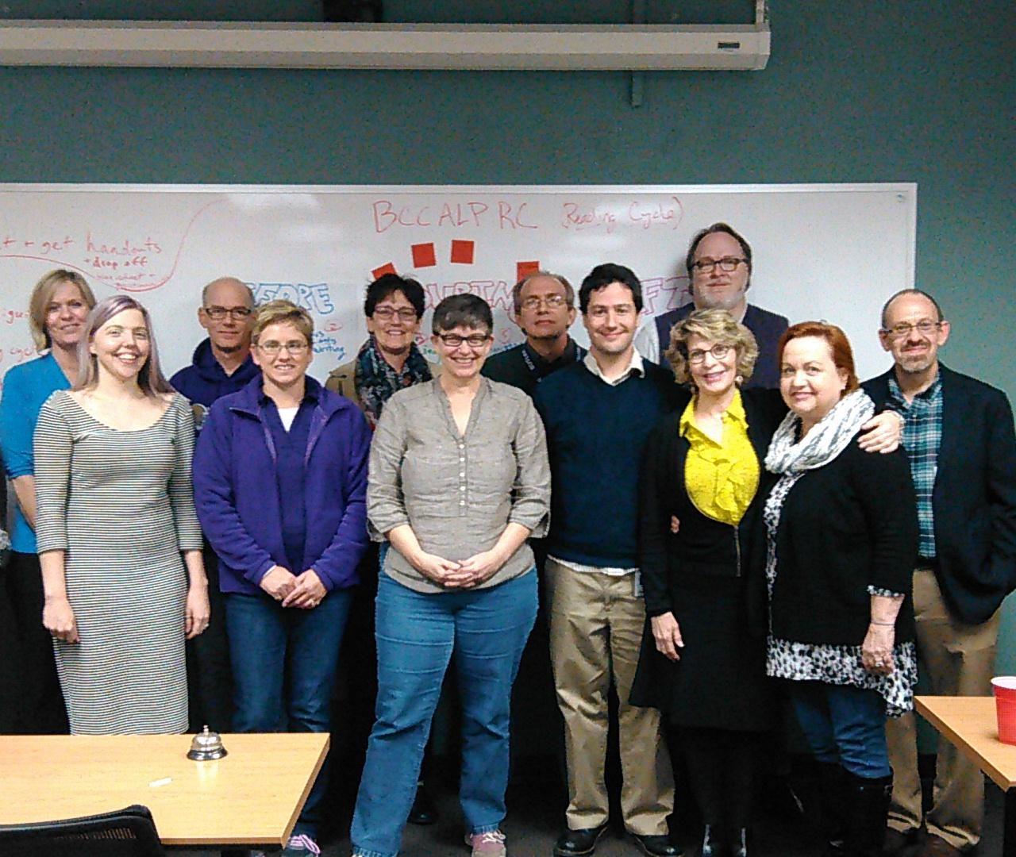
Community of Practice purposes
Training
Mentoring
Supporting
Collaborating

Slide 3
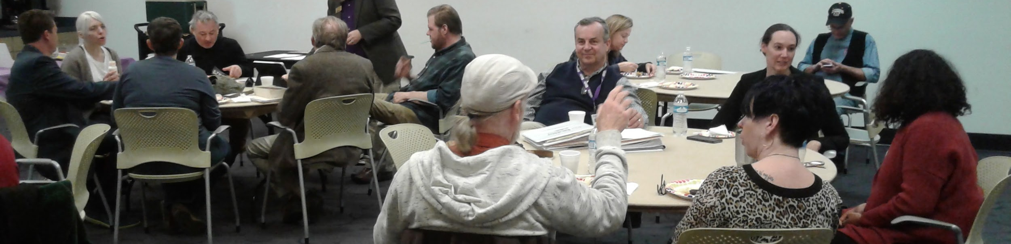
Positive Results in our Department
Enthusiasm
Collaboration
Growth mindset
Buy in
More rigorous & consistent curriculum in all writing courses
Enhanced understanding of developmental students needs and capacity to learn

Slide 4
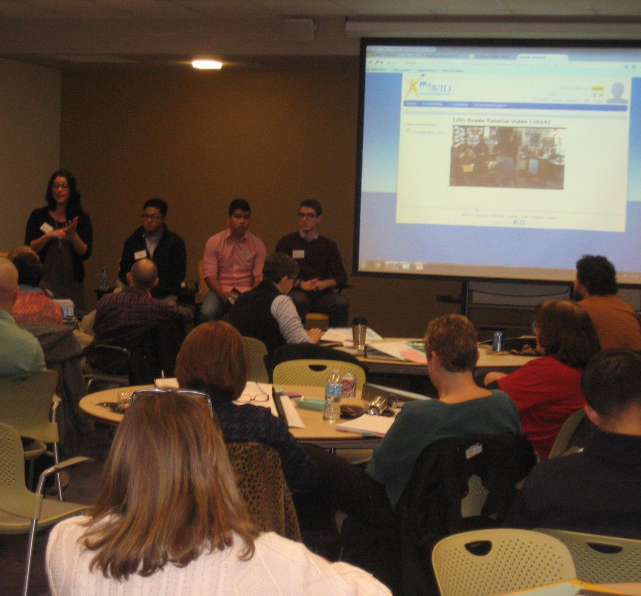
Evolution of ALP Training
Dev. Ed. Institutes for ALP, reading, math, & study skills faculty
Dev. Ed. research, best practices, specific training for discipline
Stipend for participating, additional stipend for semester follow through
First formal ALP training accomplished using model syllabi and lesson plans, shared resources shell, ALP faculty handbook and training notebook

Slide 5
Topics Covered in ALP Training
National & Butler data
How ALP works--the model & Butler policies
Backwards Design Scaffolding RIGOR
Reading Cycle Active Learning Non-cognitive
Model syllabi and lesson plans Metacognition
Shared Resources Shell Brain-based Instruction

Slide 6
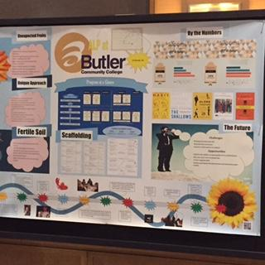
What we’ve learned about training. . .
Brain-based instruction principles apply!
Ease into training with short “Intro to ALP Canvas-shell course,” which trainees take before attending the 2-day training
Model & use active learning in training
Provide multiple trainers to vary the voices, approaches, and depth of expertise
Clarify what is essential and what is choice
Guide & support faculty as they modify their own syllabi & lesson plans

Slide 7
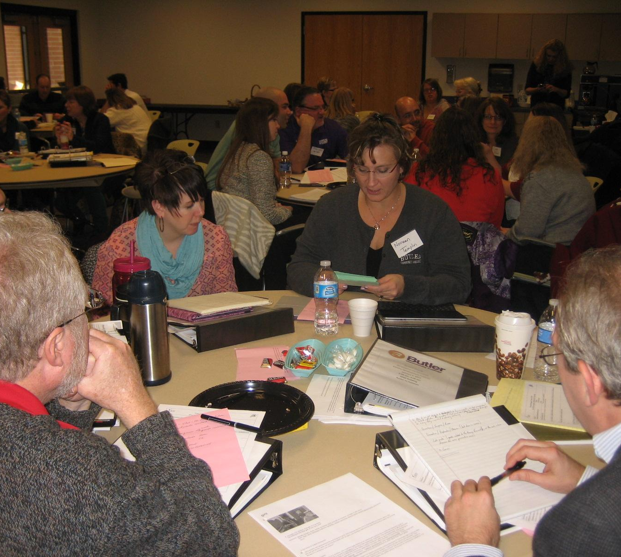
ALP Training Tools
ALP Faculty Handbook
Training notebook, articles
“Intro to ALP” Canvas pre-training course
Canvas Scavenger Hunt
ALP Student and Faculty Testimonial videos
Recorded presentations from our conference: Susan Gabriel, Student Panel

Slide 8
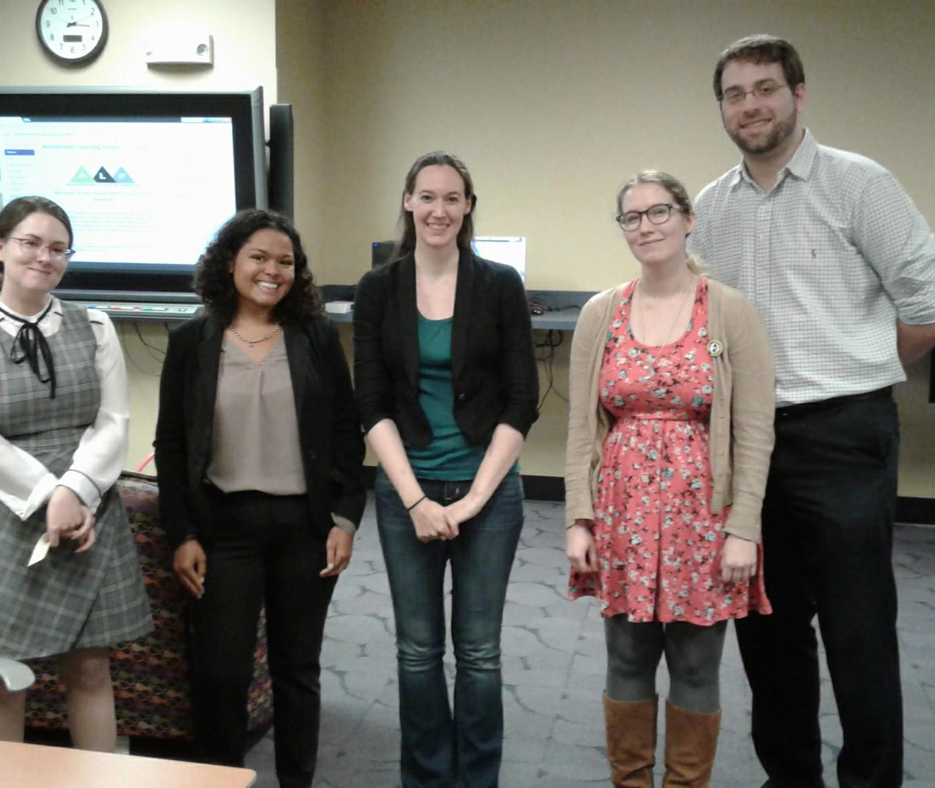
Training Incentives
Stipends for two-day training
Professional Development points--after initial training
Collaboration & training meetings--many contribute
Contributing to shared resources shell
Food & fellowship!

Slide 9
Administrator’s Point of View
Need to establish baseline, calculate results, and keep cyclical data
Need to provide release time and funds for overload projects and mentoring to build and support program
Need to document and “share our story” with leaders and public
Need to provide funds & food for training (“carrots,” energy, and appreciation)!
Need for ongoing training of ALP leadership team (conferences)

Slide 10
Keeping it going. . .
Small groups with mentors
Informal “yak and snack” sessions
End-of-semester event
Faculty sharing of strategies & learning experiences
Student testimonial videos and panels
ALP student questionnaires
Regional conference

