Slide 1
Imagining the Institution
Teaching College Culture to Underprepared Students

Slide 2
David Bartholomae
Every time a student sits down to write for us, he (sic) has to invent the university for the occasion - invent the university, that is, or a branch of it, like history or anthropology or economics or English. The student has to learn to speak our language, to speak as we do, to try on the peculiar ways of knowing, selecting, evaluating, reporting, concluding, and arguing that define the discourse of our community. Or perhaps I should say the various discourses of our community, since it is in the nature of a liberal arts education that a student, after the first year or two, must learn to try on a variety of voices and interpretive schemes - to write, for example, as a literary critic one day and as an experimental psychologist the next; to work within fields where the rules governing the presentation of examples or the development of an argument are both distinct and, even to a professional, mysterious.

Slide 3
THINK, PAIR, SHARE
What does it mean to adapt to college culture? What kinds of things do students need to know? What obstacles are there to adaptations? Do some students have a harder time adapting than others?

Slide 4
Give One, Get One
What they don’t know, might just hurt ‘em!

Slide 5
Essential Question #1:
Whose job is it to teach ‘em this stuff?
Orientation?
Parents?
Advisors?
Faculty?
Other students?

Slide 6
Glossary #1
Dean
Credit Hour
Enroll
Cert Roster
Syllabus
Midterm Exam
Final Exam
Essay
Office Hours
Semester
Text
Division
Department
Field
Analyze
Synthesize
Interpret
Apply
Evaluate

Slide 7
Essential Question #2:
HOW/WHERE/WHEN are we supposed to teach ‘em this stuff?

Slide 8
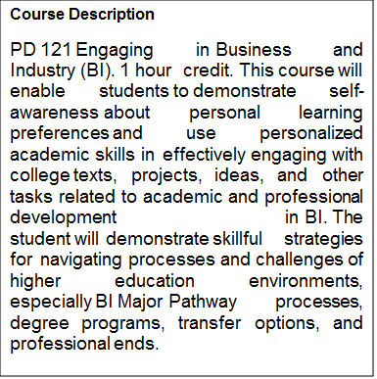
Roadmap/Orienteering
Module 1 | Intro and Organization
Module 2 | Academic and Self-Awareness P1
Module 3 | Study Strategies in the MM
Module 4 | Testing Strategies in the MM
Module 5 | Academic and Self-Awareness P2
Module 6 | Meta-Majors & Pathways
Module 7 | Writing in the MM
Module 8 | Enrollment
Module 9 | Inquiry & Thinking in the MM
Module 10 | Collaboration in the MM
Module 11 | Research in the MM
Module 12 | Issues in Meta Major/Wrap Up

Slide 9
Triangulation
Dedicated Advisor
Milestone Course Instructor
PDX Instructor
Coach/Activity Liaison
Intentional Learning Community (Cohort)

Slide 10
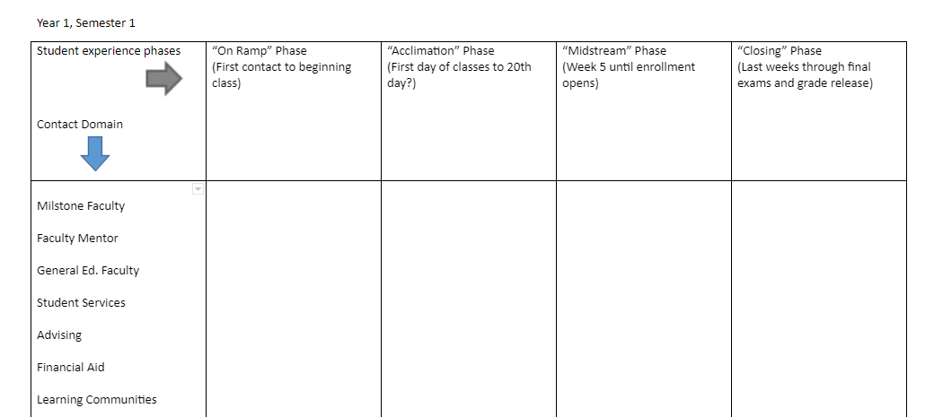

Slide 11
Jigsaw Shuffle

Slide 12
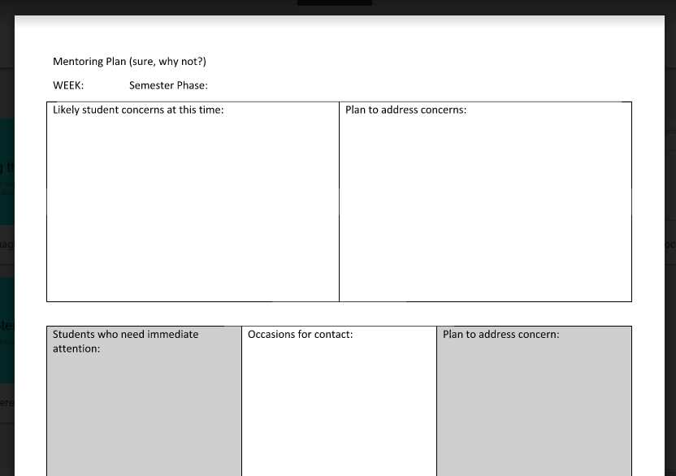
Lesson Mentoring Plan

Slide 13
Glossary #2 (Pathways terminology)
Definitions of Butler’s Guided Pathways Terminology
Guided Pathways – is Butler’s institutional framework designed to utilize highly structured pathways/programs. Our built-in mentoring and support helps students make informed choices to help them realize educational goals without limiting their options. Butler’s Guided Pathways provides students more purposeful and efficient paths to certificate/degree completion and seamless transfer.
Onboarding –refers to the processes by which students of varied backgrounds, expectations, goals, and levels of preparation are introduced to Butler’s Guided Pathways. During onboarding, students will be introduced to members of Butler’s learning community and campus service personnel. They will be guided through enrollment and financial aid processes, channeled into appropriate starting coursework, embraced by a MetaMajor cohort, and familiarized with campus services personnel and Butler’s multiple support mechanisms.
Butler will attend to each student’s personal needs through onboarding processes beginning with the first attention the school gives to each student upon his or her first expression of interest in Butler – “first contact” – and continuing on through each of four semester “phases.” (To be further developed and defined …)
MetaMajors – (non-hyphenated; two caps) a group of academic programs related by coursework or career fields. MetaMajors offer common course requirements allowing for early exploration to help students narrow their choice of pathway/program if they are undecided.

Slide 14
Pathways Glossary (continued)
Major Pathway/Program – a personalized major program of study of relevant academic coursework creating a clear roadmap to a degree, certification, or career within two years. Butler’s major pathways comprise focused sequences of courses with clear articulation to transfer institutions, related electives, and opportunities leading directly to credentials, certifications, and/or degrees.
Mentor(ing) – refers to the personal interaction by which students of varied backgrounds, expectations, goals, and levels of preparation are uniquely supported both academically and personally at Butler. Through intentional mentoring activities, students at Butler can expect to find the necessary support as they navigate their MetaMajor, Major Pathway, and campus services at Butler. Butler is committed to making every interaction with a student a mentoring moment.
Milestone Course – Butler’s milestone courses exist within a student’s Major Pathway/Program or MetaMajor to measure success towards a specific certificate or degree. To assist students in their progress towards degree attainment, Butler offers multiple academic support mechanisms and recommends students consistently engage with mentors and program liaisons to monitor student success.

Slide 15
Pathways Glossary -- In Progress
Semester Phases -- Butler will attend to each student’s personal needs through onboarding processes beginning with the first attention the school gives to each student upon his or her first expression of interest in Butler – “first contact” – and continuing on through each of four semesterly “phases.”
Onramp Phase: This phase, ranging from a students’ first contact through the first day of class refers to the channels through which unique students are supported in merging with the main stream of Butler’s culture and its various degree pathways.
Acclimation phase: During this phase, covering the period from the first day of class until Census Day (the 25% mark in each part of term, at which point BCC is required to certify each student’s participation for state purposes), focuses on helping students come to understand the features of their meta major, degree program, coursework, and the relevance of these to their educational and professional goals. During this phase, BCC students’ expectations are oriented to the realities of college-level coursework, survival-strategies, and life circumstances. Butler’s intentional developmental advising will teach students self-awareness
Mainstream phase: (from week five until enrollment opens)

Slide 16
Pathways Glossary -- In Progress
Transfer, closing, transition, transcendence Phase:
Learning Community:
Developmental Mentoring:
Developmental Advising:
Mentoring:
Support Mentoring Team Network (Triangulation team)

Slide 17
Language
CODE SWITCHING
the practice of alternating between two or more languages or varieties of language in conversation.
"the conversational code-switching of the German-American bilingual community"

Slide 18
David Bartholomae
Every time a student sits down to write for us, he (sic) has to invent the university for the occasion - invent the university, that is, or a branch of it, like history or anthropology or economics or English. The student has to learn to speak our language, to speak as we do, to try on the peculiar ways of knowing, selecting, evaluating, reporting, concluding, and arguing that define the discourse of our community. Or perhaps I should say the various discourses of our community, since it is in the nature of a liberal arts education that a student, after the first year or two, must learn to try on a variety of voices and interpretive schemes - to write, for example, as a literary critic one day and as an experimental psychologist the next; to work within fields where the rules governing the presentation of examples or the development of an argument are both distinct and, even to a professional, mysterious.

Slide 19
O.E.Q.
Collect your thoughts.
O OBSERVE
E EXPLAIN
Q QUESTION

Slide 20
How many legitimate ways are there to speak English?

Slide 21
Michel Foucault
What’s lost when we insist that our students conform to mainstream academic uses of language?
Education may well be, as of right, the instrument whereby every individual, in a society like our own, can gain access to any kind of discourse. But we well know that in its distribution, in what it permits and in what it prevents, it follows the well-trodden battle-lines of social conflict. Every educational system is a political means of maintaining or of modifying the appropriation of discourse, with the knowledge and the powers it carries with it.

