Slide 1
Transitioning from Traditional Math to Modules
A Unique Modular Approach

Slide 2
Why Transition?
National push to increase graduation rates
Focus on developmental education to improve success, retention, and completion
Math courses, particularly College Algebra, were being targeted as barriers to degree completion
1

Slide 3
Foresight 2020
Increase to 60 percent the number of Kansas adults who have earned a certificate, associates, or bachelor’s degree by 2020.
Achieve a ten percentage point increase in
retention and graduation rates by 2020.
1

Slide 4
Butler Math Data indicated
Few students who start the developmental math sequence persisted to College Algebra
The majority of students who disappeared from the sequence were dropping without completing a course
Students who failed a course and retook it the next semester had higher chance of passing that course
Students who passed a course and enrolled in the next course the following semester were most likely to pass the next course

Slide 5
Persistence to College Algebra
MA020/MA040

Slide 6
PreAlgebra Persistence to College Algebra

Slide 7
Fundamentals of Algebra Persistence to College Algebra

Slide 8
Research
Studies suggested that minimizing the amount of time student’s spend in their developmental course sequence increases the students chances for degree completion (Bailey, 2009).
McClenney and Dare (2013), suggested that students often view the multi-course progression through developmental courses as an impossible undertaking, thus reducing the likelihood that they will complete the course sequence.
Among the most popular forms of acceleration were compressed courses, paired course, and curricular redesign (Edgercombe, 2011).
011).

Slide 9
BCC's Definition of a Module Unit
Each Module is…
Equivalent to one credit hour
5 weeks in length, finishing with a minimum-score Module Exam
Taught in both Face-to-Face and Online formats
Mastery based
Utilizes Hawkes Online Learning Platform
1

Slide 10
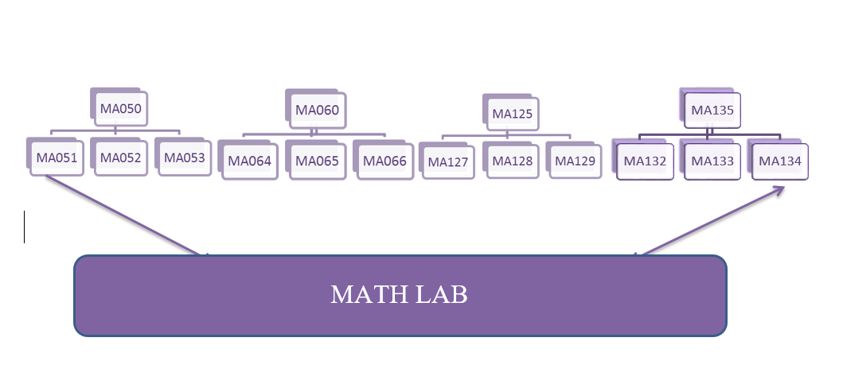
Butler’s Module Design
Breaking up curriculum into one credit hour units of study.

Slide 11
Modules vs Other Modalities
Individualized Content
Time Efficiency
Instruction

Slide 12
Modules Save Students Money
NO fee for the first "My Math Plan Assessment"
Students only pay for the Math Modules they need
Retroactive Credit
1 credit hour vs 3 credit hours
1

Slide 13
Modules Save Students Time
Testing out of Modules
Simultaneous Modules
5 -week vs 16 week for repeating Modules
1

Slide 14
Students Placement
A Series of Diagnostic Tests Designed to Help Refine Students Placement into Butler’s Math Module Curriculum. ​
​
Created using Hawkes web test feature, and correlated to Butler’s math curriculum ​
Covers Developmental Math through College Algebra​
Allows students to earn credit for what they already know​
Students only conquer the specific content they need​
1

Slide 15
How Is Butler’s Program
Working?
Fewer students misplaced​
Module pass rates have improved​
Fewer students withdraw from class​
Retention rates have improved​
Students seem happy about the module program

Slide 16
Current Data

Slide 17
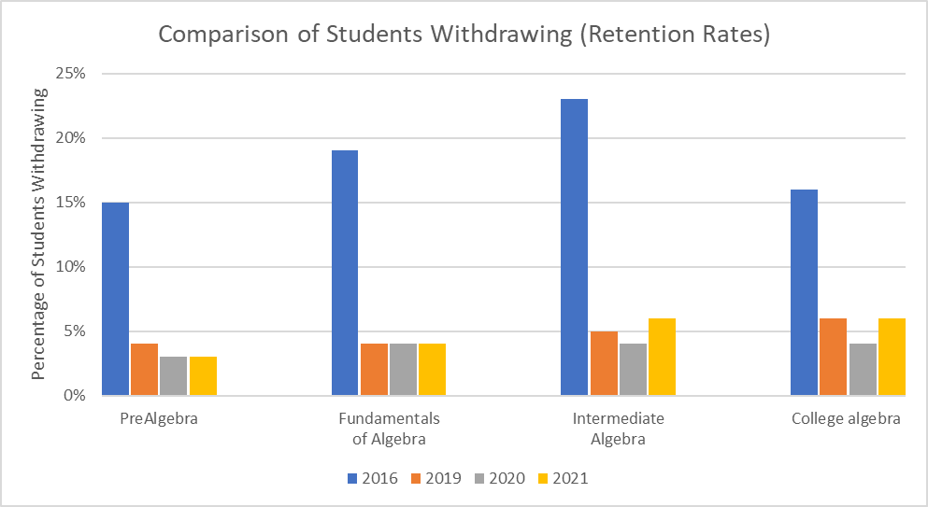
Current Data

Slide 18
What are students saying?
“I am horrible at math so by taking these modules it really helps. I love how it's broken down into 5 week courses. I don't think I could handle a whole semester of math. ”
“I love the 5 week break down of the modules though. Because I think a whole semester of math would be to much to go and test on.”
“I really enjoyed the first module of this class and I am looking forward to learning much more during this module. I love how this class is taught, very detailed instructions. I will admit, I was very nervous about math classes because I despise math, but since I am actually learning, it hasn't been too painful. ”

Slide 19
“This is currently my fifth math module since I have enrolled here at Butler. I am not quite sure what my major is going to be yet. However, math was very difficult and challenging for me in high school. Now, I am finding it more understanding and even fun. I decided to enroll last summer, after realizing that a career change is in store for me in the future. ”
“I always struggled with math in high school as well. I found that doing these modules seems to make it easier for me to understand. Not as much information to have to remember. ”
“I understand how difficult math can be, I've struggled with math since elementary school and usually couldn't do math without help. But going to the math lab and being tutored has helped me understand math a little bit better.”
“ I was afraid that i could not retain what i learned, but with it being broke down in the modules it really helps! Don't let the 5 week exam freak you out, I have let it get to me every time and i do good every time I go!”

Slide 20
Presenter Contact Information
Bethany Chandler
Lead Instructor
bchandle@butlercc.edu
Robert Zavala
rzavala@butlercc.edu
Cindy Bond
Lead Instructor
cbond@butlercc.edu

